Slide 1









2025
CarboniX
Empowering Sustainability, Trading the Future
info@carbonix.com
www.carbonix.com
Notes:
`

Slide 2
Problem
Agenda
1
Market Potential & Competitive Assessment
2
Business Model
3
Solution
4
Financial & Risk Mitigation
5

Slide 3

EU Impact: 800+ Thai exporters affected by CBAM (2026); €140B exports face carbon taxes
Domestic Market: 150M tCO2e annual emissions; 25% reduction target by 2030
Market Value: 50B baht estimated carbon credit market
Growth: 40% YoY increase; 174.52 THB/tonne average price
Timing: Strategic position at "critical juncture" in Thailand's carbon transition
Market Opportunity

Slide 4

Domestic Players
FTIX: First exchange but low volume (~1,800 tons/11 months)
TGO: Government-backed but not full trading platform
V-ETS: Limited pilot program
Our Advantages
Advanced IoT + real-time monitoring
Multi-layered verification (85% → 90% accuracy)
Comprehensive data framework
Diverse revenue streams
First-mover advantage
Thailand-specific solution
Competitive Analysis

Slide 5
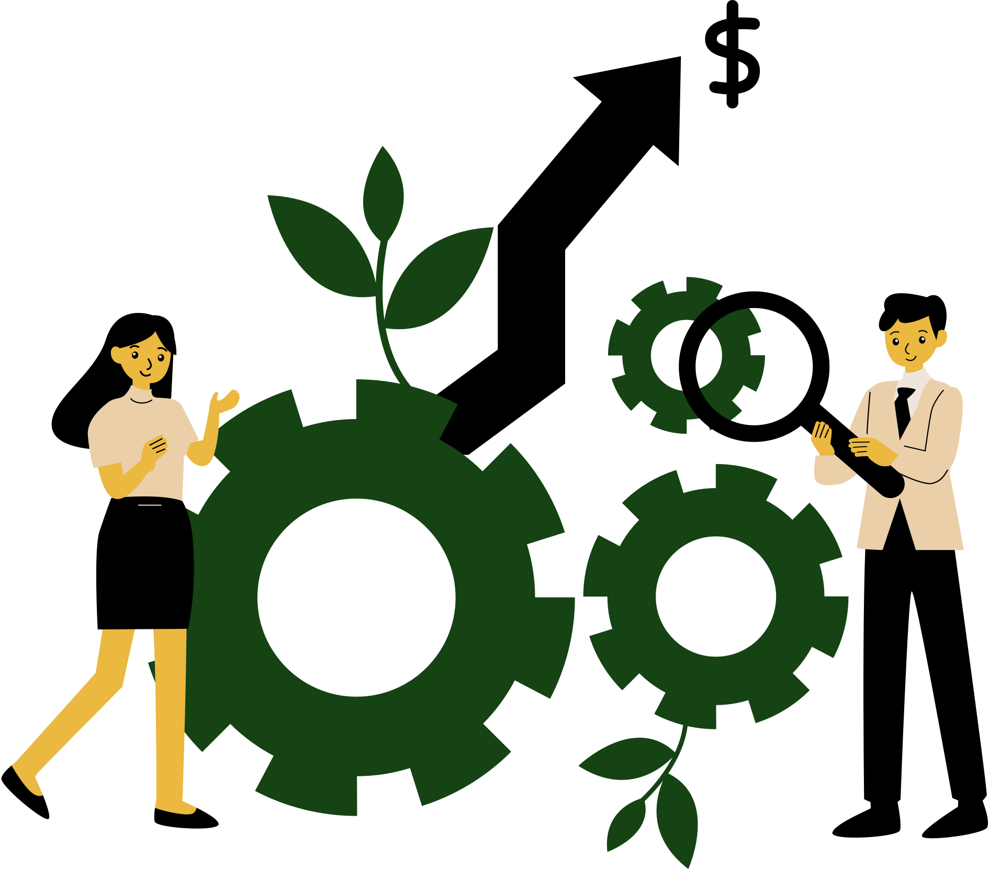


Business Model
2025
The Size and Scope of the Market
The Carbon Credit Exchange serves as a comprehensive digital marketplace, specializing in carbon credit trading, environmental, social, and governance (ESG) consulting, and sustainability management solutions.
The platform strategically generates revenue through multiple complementary streams, effectively catering to diverse client needs and industry demands.
Customer Segments
Revenue Streams
Channels
1. Corporate Clients
2. Investors & Traders
3. Project Developers
Transaction Fees
Enterprise Subscriptions
Corporate ESG Solution
Market Data & API intergration
Training & Seminars
Web & mobile applications
API integrations
Direct partnerships and sales
Workshops, webinars, and training seminars
Online self-service portal & 24/7 support center

Slide 6
Value Propositions
Customer Relationships
Customer Segments
Key Partners
Key Activities
Customer Segments
Thailand Greenhouse Gas Management Organization (TGO)
Financial institutions and banks
International verification and certification bodies (Verra, Gold Standard, TÜV SÜD)
IoT sensor manufacturers and satellite data providers
Technology vendors for data pipeline components (NiFi, Spark, Airflow) and visualization/dashboard tools
Providing consultancy on Carbon Credit and greenhouse gas reduction
Developing and managing Carbon Credit projects
Buying, selling, and managing Carbon Credit
Conducting training and knowledge sharing within the organization
A comprehensive digital marketplace uniting carbon credit trading and management solutions
Data-driven transparency and trust through IoT sensors, and automated verification systems .
Compliance support for international standards
Progressive accuracy roadmap : 85% accuracy at MVP with a clear plan to reach 90%+ via continuous data quality improvement .
Dedicated account managers
Automated onboarding with KYC/AML support via the membership system
Community engagement
Self-service portal
SLA-based 24/7 platform support
Thai Exporters & Heavy Industries
Agricultural Producers & Cooperatives
SMEs, Project Developers & Individual Traders
Banks & Financial Institutions
Businesses, Cooperatives & Public Organizations (Consultancy Clients)
Government Agencies & Verification Bodies
Key Resources
Channels
IoT sensor network and satellite imagery
Robust data architecture
Skilled teams of data scientists, software engineers, environmental experts, and compliance officers
Third-party verification bodies (Verra, Gold Standard, TGO)
Containerized microservices platform orchestrated via Kubernetes
Web & mobile applications
API integrations
Direct partnerships and sales
Workshops, webinars, and training seminars
Online self-service portal & 24/7 support center
Cost Structure
Revenue Streams
Salaries for data scientists, engineers, platform support, compliance, and consulting staff
Software development and maintenance costs
Third-party verification, certification, and audit fees for data accuracy and compliance
Marketing, stakeholder engagement, and partnership development expenses
General operational costs
Transaction Fees
Enterprise Subscriptions
Corporate ESG Solution
Market Data & API intergration
Training & Seminars

Slide 7
CARBONIX COMMUNICATION STRATEGY
KEY MESSAGE
Trade Carbon with Trust
BRAND
PERSONALITY
TRUSTED - INTELLIGENCE - INCLUSIVE
TARGET AUDIENCE
INDUSTRIAL SMES
FINANCIAL
INSTITUTION
EXPORTER
AGRICULTURAL
STRATEGIC MESSAGE
Mitigate CBAM tariffs through verified carbon reduction
Turn your data into profit through carbon credit sale
Sustainable farming now pays you back
Thailand’s reliable carbon credit investment platform
OMNI-CHANNEL
MEDIA STRATEGY
OFFLINE
(EVENT, PR NEWS)
ONLINE
(SOCIAL MEDIA, SEO, WEBSITE)

Slide 8


2025
Solution
A platform designed for creating, verifying, and trading carbon credits in Thailand
Digital Carbon Credit Market
Enviromental Monitoring
Carbon Credit Issuance & Entity Clasification
Farms Participate in creating and selling carbon credits transparently
Organizations Verify and purchase carbon credits for sustainability
Financial Institutions Connect financial systems with the carbon credit market
Sensors
Measure PM2.5, CO2, methane accurately
Real-time Data
Enhanced monitoring and analysis capabilities
Machine Learning
Increases data accuracy by more than 90%
Carbon Credit Issuance
Issue carbon credits through transparent verification processes Promote responsibility and sustainable practices
Farm and Organization Types
Net Emitters
Net Neutral
Net Absorbers

Slide 9
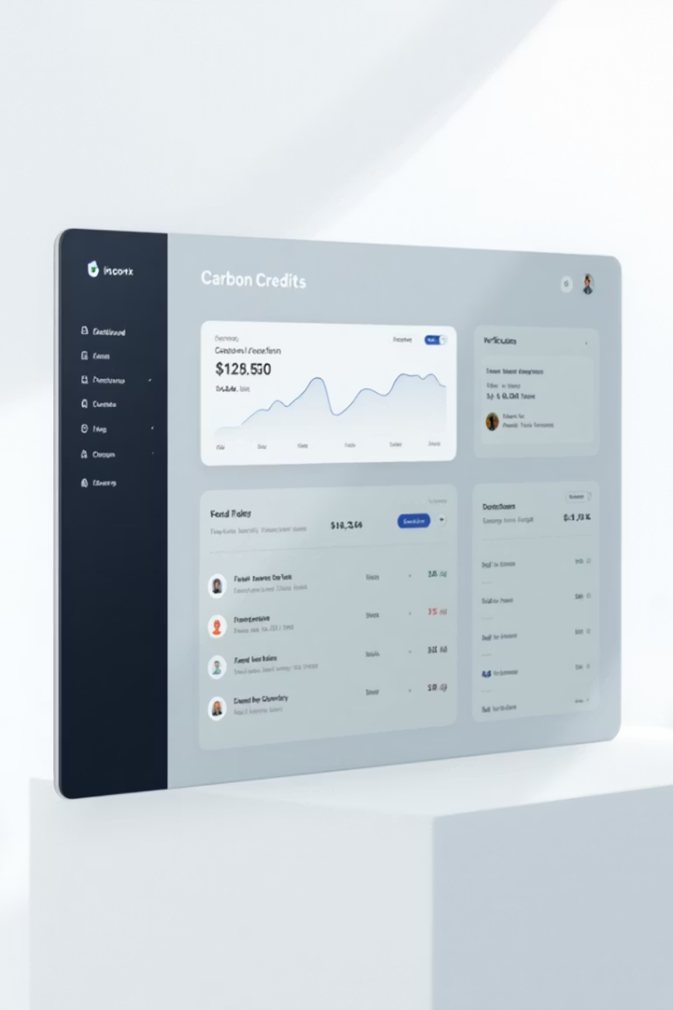
Carbon Credit Trading platform
Farms
Organizations
Participate in creating and selling carbon credits transparently
Verify and purchase carbon credits for sustainability
Financial Institutions
Connect financial systems with the carbon credit market

Slide 10


Environmental Monitoring System with IoT
Sensors IoT
Measure PM2.5, CO2, methane accurately
Real-time Data
Enhanced monitoring and analysis capabilities
Machine Learning
Increases data accuracy by more than 85%

Slide 11



Carbon Credit Issuance and Entity Classification System
Credit Issuance
Types
Produce more carbon than they absorb must purchase credits.
Issue carbon credits through transparent verification processes
Net Emitters
Promote responsibility and sustainable practices
Carbon balanced neither buy nor sell credits.
Net Neutral
Absorb more carbon than they emit can sell credits.
Net Absorbers

Slide 12

Consulting Services and Revenue Generation Tools
Consulting Services
Help with certification and strategic business planning
Training
Skill enhancement for regulatory compliance
API and Premium Data
Revenue generation channels for organizations

Slide 13
Create Carbon Credits
Trading
From environmental data and IoT
Through the platform marketplace
Vefication system
Verified Body
CarboniX
Data recording and transparent inspection
Empowering Sustainability, Trading the Future
By global standards (Verra, Gold Standard & TGO)
Public Reporting
Financial
Access to data and project results
For sustainable projects

Slide 14
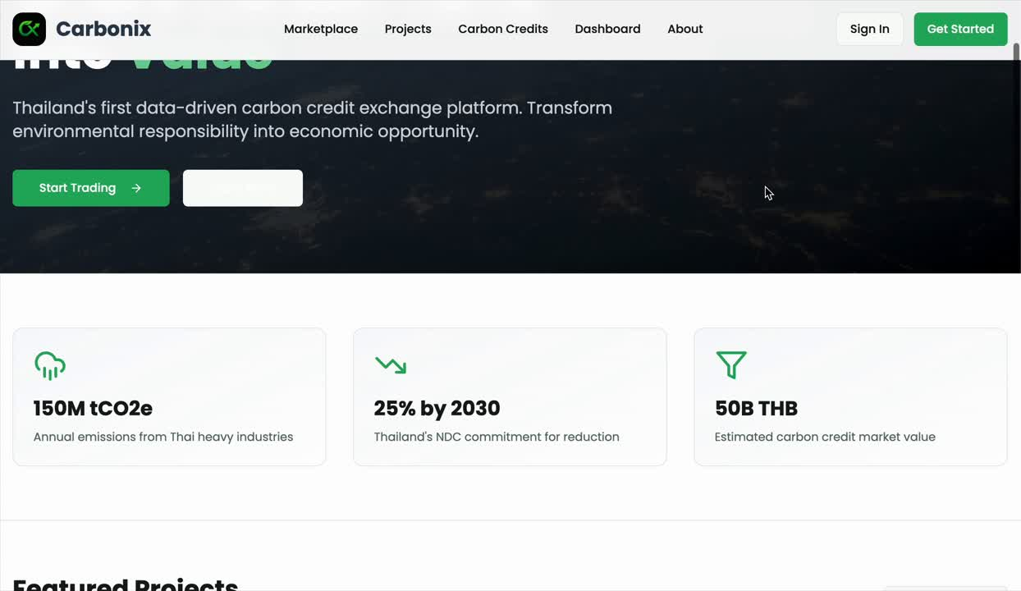

Slide 15

Financial Projection & ROI Overview

Slide 16
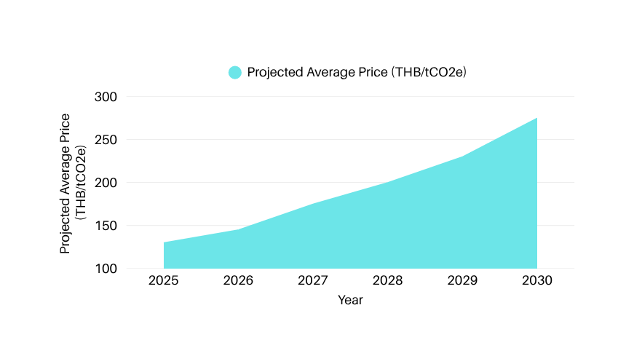
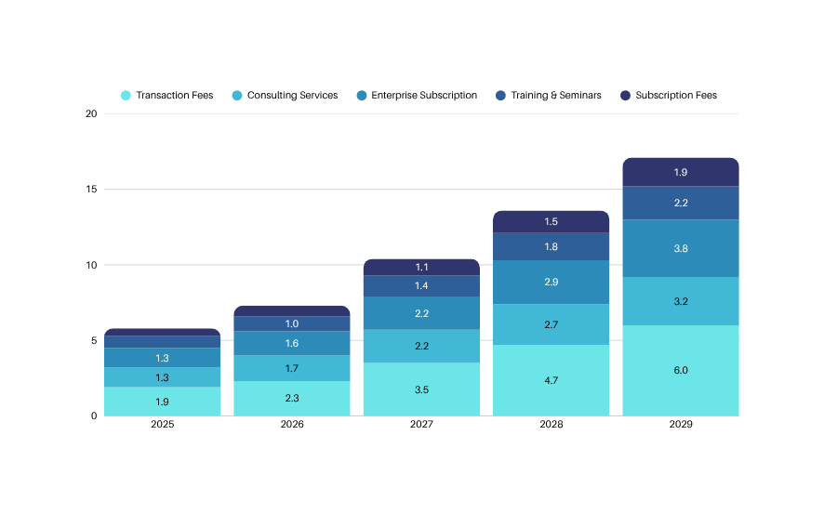
Financial Projection & ROI Overview
Our carbon platform targets Thailand’s growing voluntary carbon market with a projected 6.2M THB in first-year revenue, driven by transactions, consulting, subscriptions, and data services. With a 22% ROI and a 2.78-year payback period, the model offers strong early returns and scalable growth potential in a rising ESG-focused economy.
Diversified Revenue Streams
Revenue Projections (MTHB)
Carbon Trading Base: 330M THB projected market; aligned with global fee benchmarks
Consulting & Training: High-margin, value-added services targeting key industries
Subscription Growth: Tiered pricing for SMEs to enterprises; strong recurring potential
Platform Expansion: API, analytics, and compliance tools for ecosystem integration
Positioned for Growth: Revenue scales with market maturity and ESG adoption

Slide 17

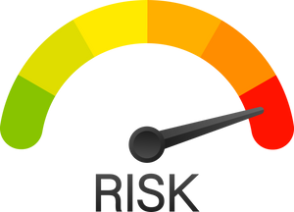





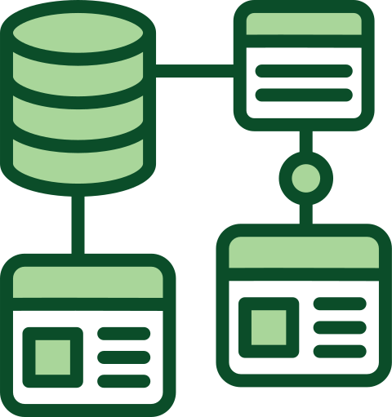

Risk Mitigation
Strategic & Regulatory Risks
Operational Risks
• Diversify credit types (forestry, technology)
• Engage in lobbying and scenario planning
• Use robust verification (ICROA, VERRA)
• Prioritize transparency and stakeholder trust
• Implement redundant systems and disaster recovery
• Utilize AI for fraud detection
• Apply credit insurance and collateral
• Adopt cloud infrastructure for scalability
Financial Risks
Data Privacy, Security & Compliance
• Maintain reserve capital and credit lines
• Use credit scoring and diversify buyers
• Hedge currency and interest rate exposures
• Use fixed-rate contracts for stability
• Encrypt data and use multi-factor authentication
• Conduct compliance audits regularly
• Deploy surveillance tools to prevent manipulation
• Enforce strict AML and KYC processes

Slide 18

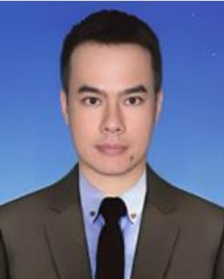
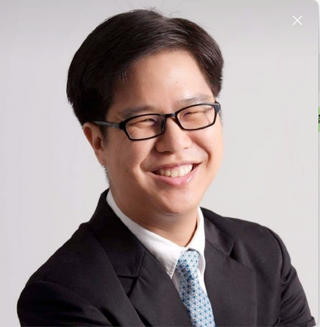
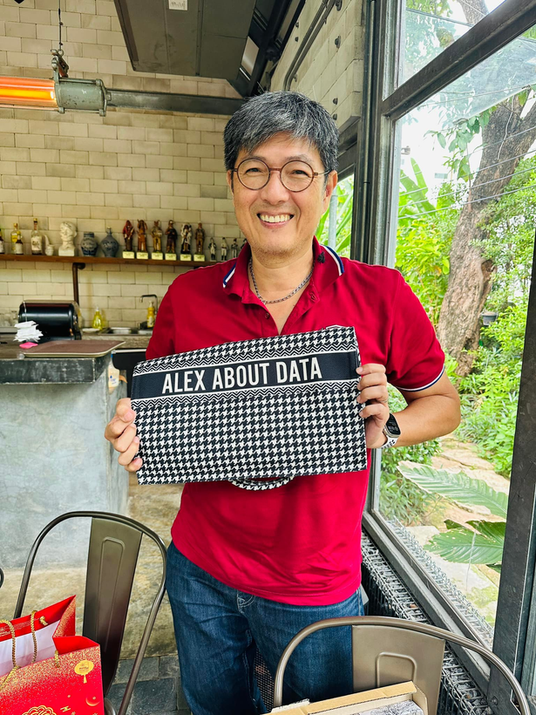
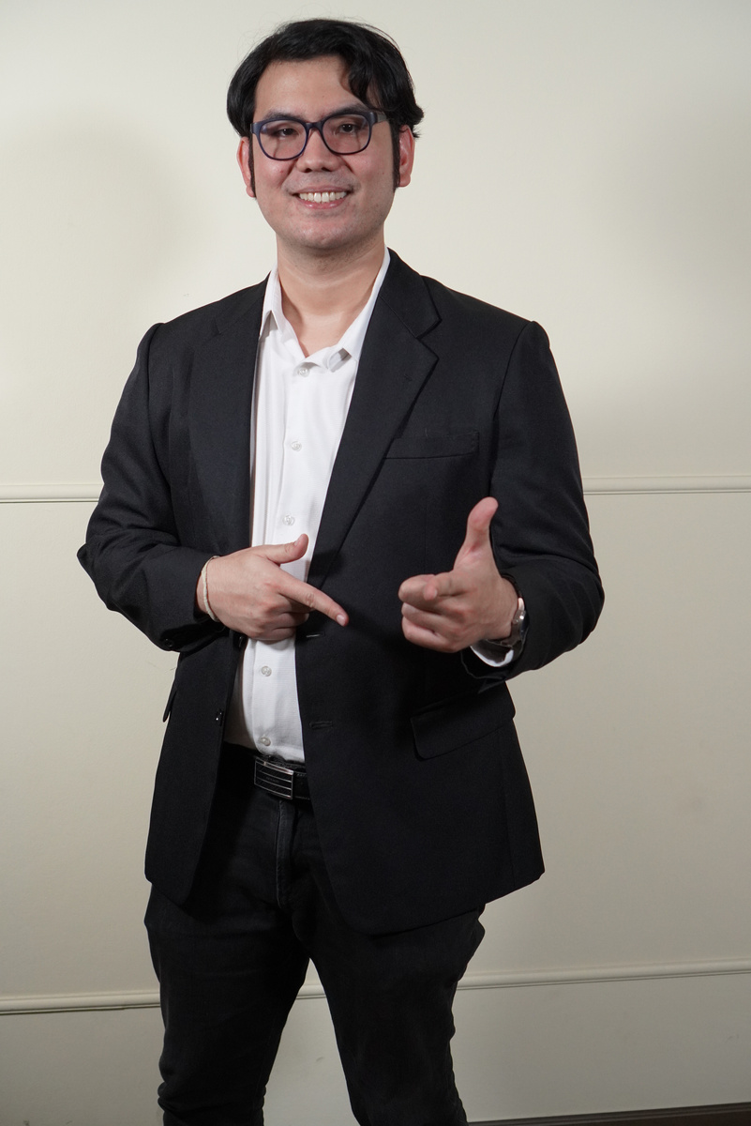

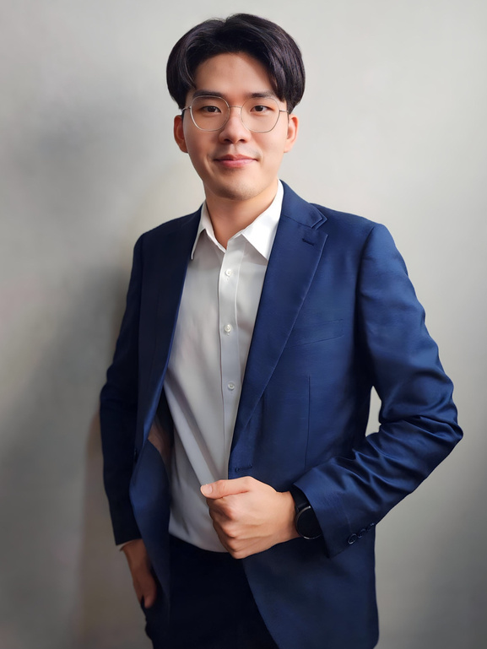


CarboniX
Phanuwat Chatchinnarat
Tanyavat
Kaew Pradit
Ruj Kasetsuwan
Asst. Prof. Worapol Pongpech
Advisor
Our Team
The People Behind the Vision
Our Commitment
Through relentless ideation and teamwork, CarboniX delivers a future-ready solution that balances profitability with planetary impact, paving the way for a sustainable tomorrow.
Atisak Tongdeeput
Kanokpon Cheevanichapan
Piyawat
Visessri
Watanyu Lertpongpreecha

Slide 19

2025
Thank You
info@carbonix.com
www.carbonix.com

